Slide 1
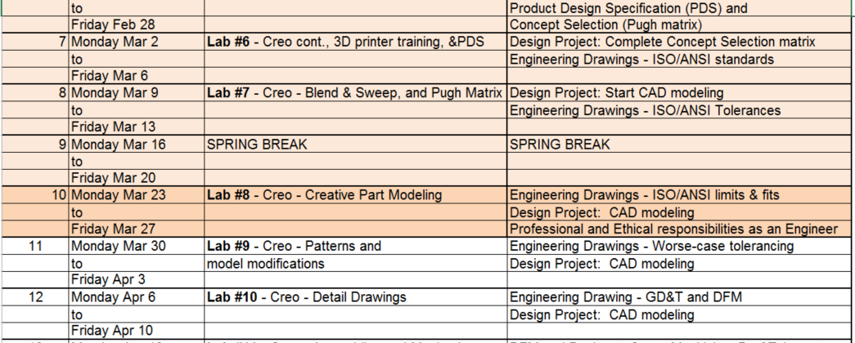
Lecture Class Slide Presentation 3-23-2020
Welcome to ME170 in on-line mode – I hope you had a great break!
Today there is no video to go with this lecture, just slides and a slightly more lengthy assignment than usual
There are some video clips embedded in the slides, so please watch them
And don’t forget to complete the Lecture Class assignment for this Lecture Class within the next 3 days for full credit
As before I will review the class schedule on Tuesdays and highlight the week ahead
For your Project you should be working with your team mates on CAD modeling you agreed product concept
In Lab continue working through the assignments in the Creo text book as outlined in Lab Assignment #8 posted
In class we will review Ethical responsibilities we have as mechanical engineers, particularly as we design products for the consumer marketplace today, and
On Thursday we will continue working through the Engineering Drawing set of notes and look at standard “Limits and Fits”

Slide 2
What are Ethics?
Ethics is a rational study of moral dilemmas in human action.
Morals are shortly defined as codes or guides of conduct (implicit or explicit) that are based on personal long-lasting beliefs and values or those of surrounding society.
A personal act can be considered moral, immoral or amoral from the point of view of ethical studies:
Moral - an act or thought that is in line with personal and societal moral codes
Immoral - an act or thought that is against personal or societal moral codes
Amoral - an act or thought that does not reflect choice based on moral codes
Philosophy of Ethics - The study of what is the right thing to do

Slide 3
Who You Are – as a Designer, Engineer, or Person?
It is very easy to understand that almost any act or thought can be considered both moral and immoral at the same time, if one considers proper points of view. However, this does not make the study of ethics (i.e. The study of moral dilemmas) any less significant: just like in design there are no single right solutions – only choices that have pros and cons attached to them.
To prepare yourself for the multitude of ethical considerations you can start by examining:
your own stance as a designer,
your own values,
who you are designing for
what kind of values are you trying to embed in your design solutions, and
why?

Slide 4
American Society of Mechanical Engineers
ASME CODE OF ETHICS OF ENGINEERS
The 3 Fundamental Principles
Engineers uphold and advance the integrity, honor and dignity of the engineering profession by:
I. Using their knowledge and skill for the enhancement of human welfare
II. Being honest and impartial, and serving with fidelity their clients (including their employers) and the public
III. Striving to increase the competence and prestige of the engineering profession.

Slide 5
ASME - CODE OF ETHICS OF ENGINEERS
The 10 Fundamental Canons
Engineers shall hold paramount the safety, health and welfare of the public in the performance of their professional duties.
Engineers shall perform services only in the areas of their competence; they shall build their professional reputation on the merit of their services and shall not compete unfairly with others.
Engineers shall continue their professional development throughout their careers and shall provide opportunities for the professional and ethical development of those engineers under their supervision.
Engineers shall act in professional matters for each employer or client as faithful agents or trustees, and shall avoid conflicts of interest or the appearance of conflicts of interest.
Engineers shall respect the proprietary information and intellectual property rights of others, including charitable organizations and professional societies in the engineering field.
Engineers shall associate only with reputable persons or organizations.

Slide 6
ASME - CODE OF ETHICS OF ENGINEERS
The Fundamental Canons (continued)
Engineers shall issue public statements only in an objective and truthful manner and shall avoid any conduct which brings discredit upon the profession.
Engineers shall consider environmental impact and sustainable development in the performance of their professional duties.
Engineers shall not seek ethical sanction against another engineer unless there is good reason to do so under the relevant codes, policies and procedures governing that engineer’s ethical conduct.
Engineers who are members of the Society shall endeavor to abide by the Constitution, By-Laws and Policies of the Society, and they shall disclose knowledge of any matter involving another member’s alleged violation of this Code of Ethics or the Society’s Conflicts of Interest Policy in a prompt, complete and truthful manner to the chair of the Committee on Ethical Standards and Review.

Slide 7
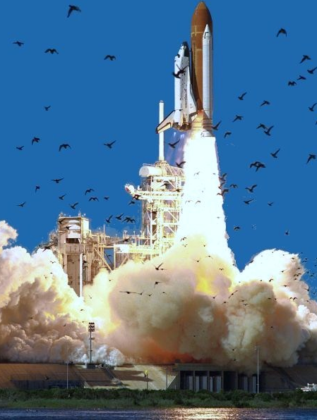
Shuttle Challenger Disaster of 1986
Disintegrated 73 seconds into its flight after an O-ring seal on the solid rocket motor failed. The shuttle was destroyed and all seven crew members were killed.
Unethical decision-making forum ultimately produced the management decision to launch Challenger; despite attempts to stop the launch by the Morton Thiokol engineers.
In January, 1985, escalation of joint seal problems should have signaled either stopping the flights or as a minimum, changing the launch commit criteria to prevent launching below 53 °F (12 °C).
Accountability, professional responsibility and ethical conduct were rigorously reviewed over many months.
Video Link

Slide 8
Challenger - Solid Rocket Motor (SRM)
Joint Configuration
Secondary Seal
Primary Seal
180 load carrying pins, Two O rings – Primary and Secondary seals
Pressurization of the motor to 1004 psi (6.92 x 106 pascals) causes the gap dimension to increase 0.042 inches (1.07 mm).

Slide 9
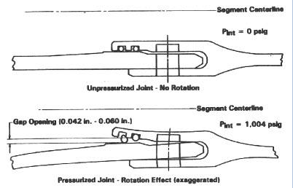

Slide 10
Challenger (Cont.)
The affects of cold temperature on O-ring resiliency, is defined as the ability of the seal to restore itself to a round cross sectional shape after the squeeze on the seal is removed.
The preliminary resiliency testing, which was requested by a lead engineer at MTI, was performed in March 1985 and showed that a low temperature of 50 °F (10 °C) was a problem, as the seal material could not follow the rate of gap opening and lost contact with its mating surface. The significance of this data was that the seal erosion and blow-by problem was known to occur within 0.60 seconds during the motor ignition transient.
The preliminary test configuration:
O-ring seal placed into a flight size groove in a flat plate and compressed the seal 0.040 inches (1.02 mm) with another flat plate.
The plates were separated 0.030 inches at flight rate
No loss of seal contact at 100 °F (38 °C);
Loss of seal contact for 2.4 seconds at 75 °F (24 °C)
and loss of seal contact for in excess of 10 minutes at 50 °F (10 °C).
Everyone on the program, working with the joint seal problems, was now aware of the influence of low temperature on the field joint seals.
The data was discussed with MTI Engineering Management, but was thought to be too sensitive by them to release to anyone.

Slide 11
Ethical Decisions - Morton Thiokol and the Space Shuttle Challenger Disaster, Roger M. Boisjoly, Former Morton Thiokol Engineer, Willard, Utah
Telecon Meeting Account:
“The major activity that day focused upon the predicted 18 °F (-8 °C) overnight low and meetings with Engineering Management to persuade them not to launch below 53 °F (12 °C) – high probability of no secondary seal capability - bench testing showed o-ring not capable of maintaining contact with metal parts.
Joe Kilminster of MTI was asked by Larry Mulloy of NASA for his launch decision. Joe responded the he did not recommend launching based upon the engineering position just presented.
Then Larry Mulloy after some time giving his views and interpretation of the data that was presented concluded that the data presented was inconclusive.
Joe Kilminster asked for a five-minute, off-line caucus to re-evaluate the data and as soon as the mute button was pushed, our General Manager, Jerry Mason, said in a soft voice, "We have to make a management decision." I became furious when I heard this, because I sensed that an attempt would be made by executive-level management to reverse the no-launch decision.
“The managers were struggling to make a list of data that would support a launch decision, but unfortunately for them, the data actually supported a no-launch decision”…however, despite this, the decision to launch was made!

Slide 12
Ethical Decisions - Roger M. Boisjoly testifies:
The disaster resulted in a 32-month hiatus in the shuttle program and the formation of the Rogers Commission, a special commission appointed by United States President Ronald Reagan to investigate the accident.
Roger M. Boisjoly testified to the commission and gave a detailed honest technical report. He was ultimately forced to take early retirement for his whistleblowing sins. The Rogers Commission found that:
NASA's organizational culture and decision-making processes had been a key contributing factor to the accident.
NASA managers had known that contractor Morton Thiokol's design of the SRMs contained a potentially catastrophic flaw, but they failed to address it properly.
They also ignored warnings from engineers about the dangers of launching on such a cold day and had failed to adequately report these technical concerns to their superiors.
The Rogers Commission offered NASA nine recommendations that were to be implemented before shuttle flights resumed.

Slide 13
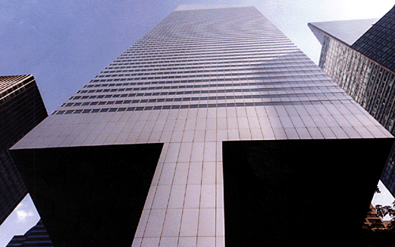
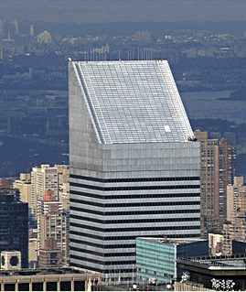
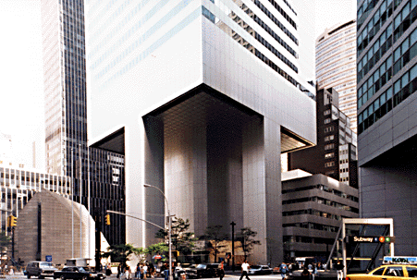
THE CITICORP CENTER
One of the largest skyscrapers in New York City – Ethics Case Study
Video case study

Slide 14
William LeMessurier – Structural Engineer for the Citicorp Building
(One of the most highly regarded structural engineers and designers in the world)
After completion and occupation of the building, prompted by a question from a student, LeMessurier discovered a potentially fatal flaw in the building's design and construction: the skyscraper may not be able to withstand 70-mile-per-hour (113 km/h) wind gusts at specific angles.
His simulations showed that if hurricane-speed winds hit the building at a 45-degree angle there was the ‘potential’ for catastrophic failure. The wind speeds needed to topple the building were predicted to occur in New York City every 16 years.
LeMessurier agonized over how to deal with the problem - making it known to the wider world risked ruining his professional reputation. But with hurricane season fast approaching, he took the bold decision to approach Citicorp directly, and advise them of the need to take swift remedial action.
He convinced Citicorp to hire a crew of welders to repair the fragile building without informing the public, a task made easier by the press strike at that time.
For the next three months, a construction crew welded two-inch-thick steel plates over each of the skyscraper's 200 bolted joints during the night, after each work day, almost unknown to the general public.

Slide 15
Six weeks into the work, a major storm, Hurricane Ella (1978 Atlantic hurricane season), was off Cape Hatteras and heading for New York. With only half the reinforcement finished, New York City was hours away from emergency evacuation. Luckily, Ella turned eastward and veered out to sea, buying enough time for workers to permanently correct the problem.
Despite the fact that nothing actually happened as a result of the engineering gaffe, the crisis was kept hidden from the public for almost 20 years.
It was publicized in a lengthy article in the New Yorker in 1995. LeMessurier's act of alerting Citicorp to the problem inherent in his own design is now used as an example of ethical behavior in several engineering textbooks.
Although, LeMessurier was criticized for insufficient oversight of the construction, for misleading the public about the extent of the danger during the reinforcement process, and for keeping the engineering insights from his peers for two decades.
After the modifications were completed, the building is now generally considered to be one of the most structurally sound skyscrapers in the world

Slide 16
Ecology and Environment
What is ethical in terms of ecology?
Are you solving the problem or merely contributing less to it?
Are you promoting ecological preservation or just paying lip service to it?
Beware of 'greenwashing' (appearing to be ecological just for the added marketability)
Greenwashing video example
“The primary concerns are climate change, multiple forms of pollution, human population growth, scarcities of some renewable and nonrenewable resources, human-induced losses in biodiversity, the interactive dynamics of ecological degradation and economic patterns of consumption and distribution, and, increasingly relevant, the environmental effects of genetic manipulations.”

Slide 17
Needs and Wants?
Serve needs not only wants
Learn to identify what people really need instead of what they want, because of external influences
Do not be a slave to needs, appreciate wants as well
Practice balance between the two

Slide 18
Multiculturality
Are your project or product goals bound by cultural imperatives?
Which and Why?
Should you change them?
Should you make your design solution local (works for specific cultures) or global (works in as many cultures as possible)?

Slide 19
Made in the USA
John Budinski, quality control engineer at Clarke Engineering, has a problem. Clarke contracted with USAWAY to supply a product subject to the requirement that all parts are made in the United States.
Although the original design clearly specifies that all parts must satisfy this requirement, one of Clarke's suppliers failed to note that one of the components has two special bolts that are made only in another country. There is not time to design a new bolt if the terms of the contract are to be met. USAWAY is a major customer, and not meeting the deadline can be expected to have unfortunate consequences for Clarke.
John realizes that the chances of USAWAY discovering the problem on their own is slim. What should John do?
Keep quiet and allow the product to go out as is.
Other ?

Slide 20
Unfair Quoting?
At T&D Manufacturing, the procedure to obtain needed tooling is to have the tools designed in house by company tool engineers. When the design is approved, part prints and specifications are mailed to at least three approved outside vendors. The outside shop supplying the best price and delivery date is awarded a contract to produce the tool.
The Head of the T&D tool and die department requests that management allow them to offer a price to produce the tooling internally. This request is approved. Next the department head places a call to the Purchasing Department and asks for the prices obtained from the outside vendors before he submits his quote.
Is there anything wrong with the department head making this request?
How should Purchasing respond?
Send the department the outside quotes and allow a week to produce their own price?
Refuse the request as being unethical?
Tell the department head that he will receive the outside prices after the job is awarded?
Other.

Slide 21
Made in China
“Millions of young Chinese men “voluntarily” work backbreaking hours in what amount to slave labor camps, where the National Labor Committee for Human Rights has documented 98-hour workweeks in factories over 100°F, a ban on talking during work hours, 24-hour surveillance, and compulsory unpaid overtime.
Top wages are 10 cents an hour.
Average pay in China’s “Special Economic Zones” is three cents an hour.
Other workers are paid just 36 cents for more than a month’s work—making just 8/100th of a cent an hour.
In air thick with dust and chemical solvents, workers handle toxic glues without gloves alongside machines that roar like express trains…”
From “Made in China” by William Thomas

Slide 22
Garment Manufacture in India
“Labor is highly exploited, wages are low, hours of work are long and there is no job security. The garment sector recruits women aged between 14 to 30 years. The social conditions which force women to be of a shy nature, economically push them to take jobs in these garment factories. But once they are in, they have to face all kinds of sexual harassment. Indirect and direct sexual advances, insults, vulgar verbal abuse are all common in these sweatshops. Garment workers are exploited to the maximum.
Basic facilities such as toilets, ventilation and even drinking water are luxuries in these factories. There are restrictions for using the toilets. Women are not allowed to sit to do their work.
Among the workers on the upper rungs of the ladder, tailors get a maximum of 140 rupees ($3) per day. Taking an average of 10 hours a day worked, an hour’s wage would not even fetch a kilo of vegetables.
There are no measures taken to maintain industrial safety. As there is no proper ventilation, dust from the textile waste gets into the lungs of the workers. Many suffer from throat cancer due to these unhealthy working conditions. Anaemia, sleeplessness, miscarriages, leg and back pain are widespread among women garment workers”
brand names such as Mexx, Puma and O’Neil
“Garment factories - a hell on earth” Nirmala Krishna

Slide 23
Cultural Issues
Product Compatibility
Pampers in Italy
When Proctor & Gamble tried to market in Italy their highly successful Pampers diaper it was a failure…until they discovered why?
Italian mothers did not like to see the babies naval exposed.
Solution: increased the front section for the Italian market
Non-Alcoholic Beer in Saudi Arabia
Beer a no-brainer
But why not non-alcoholic beer

Slide 24
Diaper Innovation & the Environment
When Proctor & Gamble launched the first disposable diaper in 1961, Pampers, housewives had fewer loads of laundry to do, and they no longer needed to fear that their husbands would puncture the baby with safety pins.
BUT….
Is it wise to use 3.4 billion gallons of oil and over 250,000 trees a year to manufacture disposables that end up in our already overburdened landfills? Thirty percent of a disposable diaper is plastic and is not compostable….over 100 intestinal viruses, is brought to landfills via disposables. This may contribute to groundwater contamination and attract insects that carry and transmit diseases. In 1990, 18 billion disposables were thrown into United States landfills.

Slide 25
Design for Sustainability
How do we reconcile needs to consume with needs to conserve?
We know that it requires resources to meet human needs, but we also value caring for resources.
We have value conflicts between the economic and status seeking motivations for consumption and the ethics of conservation.
What can we do to show more care and preserve things? How can we show care about resources as not something we use up but something we borrow from future users.
Can we make aesthetics and conservation compatible?
Does recycling automatically mean clutter and messy boxes in hallways, or are there beautifully designed solutions to encourage even diehards to recycle?

Slide 26
Design for Sustainability (cont)
Can we select materials and produce goods that last longer to cut down on consumption?
What designs will endure and which will go out of date? How can we tell in advance?
How many things do we make or acquire with the idea of it being so valuable that it can serve for more than one generation?
What are the ethical issues around planned obsolescence?
Can we cultivate, through design, to find pleasure in preservation of resources, or are we simply conditioned to find more pleasure in the consumption of resources?

Slide 27
Sustainability Ethic
Every person ultimately wants to leave the world a better place for having lived. What better philosophy of life could one imagine?
Is the place more beautiful or uglier? If it is more beautiful, how sustainable is it?
We know that nature sustains itself beautifully. What then can we design that is as beautiful and sustainable as nature?
How much are we willing to commit to maintenance and preservation of constructed beauty?
E.g. Perhaps consider making your product from BioPlastics - PLA (polylactic acid) made from crops, such as corn

Slide 28
CLOSING REMARKS
Ethics is not an easy subject and I encourage you to prepare yourself for the multitude of ethical considerations in you career by reviewing these notes
For your design projects, consider some of these important ethical expectations and considerations in the design; and highlight them in your project reports.
Work on your design projects and get as much CAD modeling as you can this week. Divide up some of the tasks by structuring the product into practical sub-assemblies.
Have fun with this creative and rewarding design process!

